Slide 1

VSB Power Line Fault Detection
Using Machine Learning Classification Models to Detect Partial Discharge Faults in Covered Conductors in the Real Environment
Jeffrey Egan / February 2019
Notes:
Using Machine Learning Models to Complete OkCupid Demographics Data Sets: An Initial Investigation

Slide 2
Outline
Project Overview
Data Examination
Data Pipeline Design
Signal Processing
Machine Learning Model
Prototyped Models and Preliminary Results
Final Model(s) Selection
Conclusions

Slide 3
Project Overview
Medium voltage overhead power lines run for hundreds of miles to supply power to cities. These great distances make it expensive to manually inspect the lines for damage that doesn't immediately lead to a power outage, such as a tree branch hitting the line or a flaw in the insulator. These modes of damage lead to a phenomenon known as partial discharge — an electrical discharge which does not bridge the electrodes between an insulation system completely. Partial discharges slowly damage the power line, so left unrepaired they will eventually lead to a power outage or start a fire.
Your challenge is to detect partial discharge patterns in signals acquired from these power lines with a new meter designed at the ENET Centre at VŠB. Effective classifiers using this data will make it possible to continuously monitor power lines for faults.
ENET Centre researches and develops renewable energy resources with the goal of reducing or eliminating harmful environmental impacts. Their efforts focus on developing technology solutions around transportation and processing of energy raw materials.
By developing a solution to detect partial discharge you’ll help reduce maintenance costs, and prevent power outages.
Notes:
Medium voltage overhead power lines run for hundreds of miles to supply power to cities. These great distances make it expensive to manually inspect the lines for damage that doesn't immediately lead to a power outage, such as a tree branch hitting the line or a flaw in the insulator. These modes of damage lead to a phenomenon known as partial discharge — an electrical discharge which does not bridge the electrodes between an insulation system completely. Partial discharges slowly damage the power line, so left unrepaired they will eventually lead to a power outage or start a fire.
Your challenge is to detect partial discharge patterns in signals acquired from these power lines with a new meter designed at the ENET Centre at VŠB. Effective classifiers using this data will make it possible to continuously monitor power lines for faults.
ENET Centre researches and develops renewable energy resources with the goal of reducing or eliminating harmful environmental impacts. Their efforts focus on developing technology solutions around transportation and processing of energy raw materials.
By developing a solution to detect partial discharge you’ll help reduce maintenance costs, and prevent power outages.

Slide 4
Data Examination

Slide 5
Data Pipeline
Raw 3⌀ Signal
Discrete Wavelet Transform
Nth Discrete Difference Detrending
Feature Extraction
Train Classifier Models
Test Classifier Models
Iterate on Pipeline Variables

Slide 6
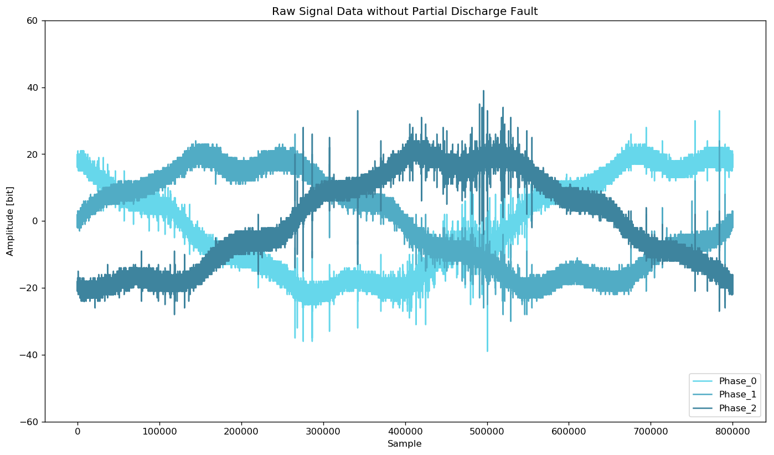
Data Pipeline – Signal Processing

Slide 7
Data Pipeline – Feature Extraction

Slide 8
Prototype Classification Models

Slide 9
Preliminary Results

Slide 10
Final Model Selection and Refinement

Slide 11
Classifier Results

Slide 12
Conclusions

